Slide 1
CS489 Fitness Tracker
Aidan DeMuth, Tommy Gaffney

Slide 2
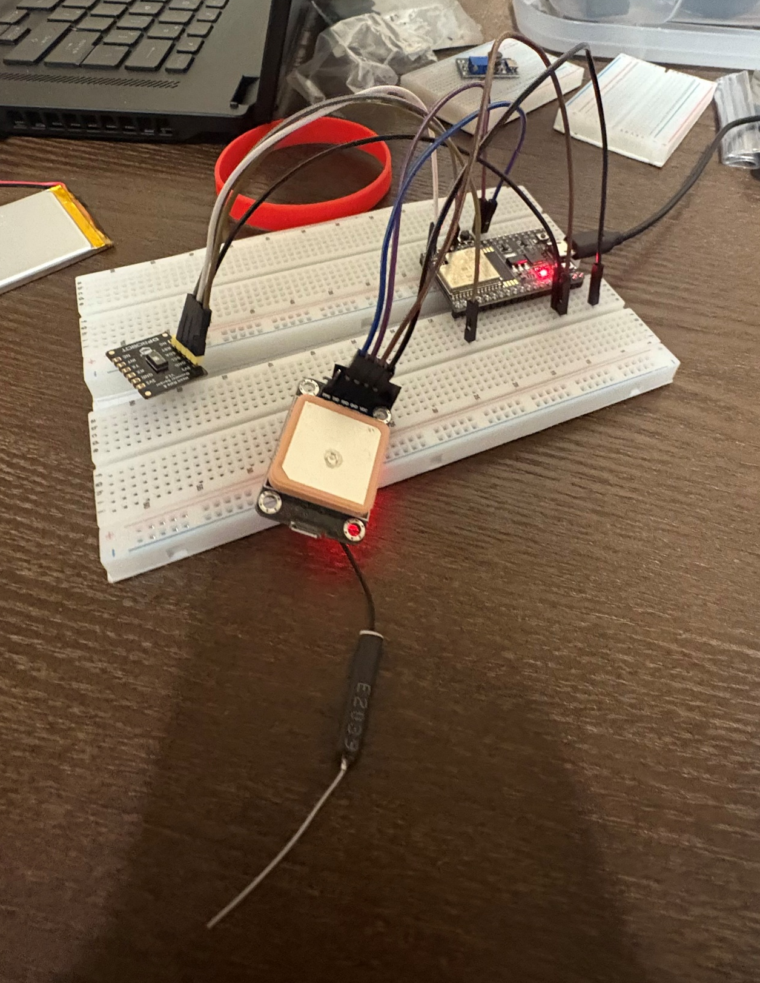
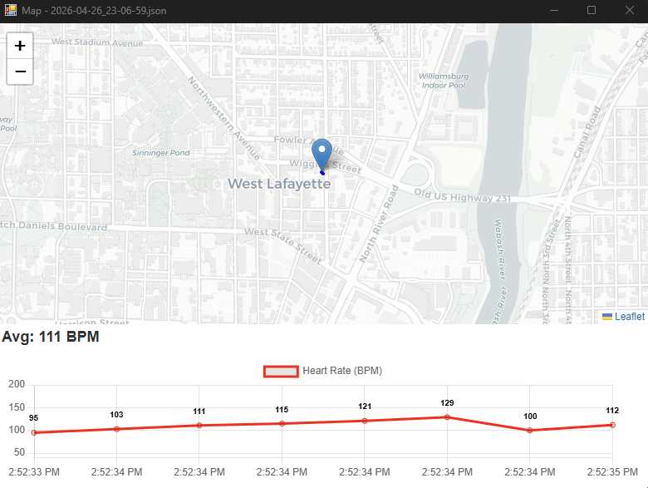
Problem to be solved
Athletes and health enthusiasts want detailed data about their workouts and training to measure improvement
Most options available are expensive (Anywhere from $200-$500+ for core features)
Collecting large volumes of data is necessary, and unrealistic by hand
Our fitness tracker will automatically log exercises, and the application will display them
Notes:
Aidan

Slide 3
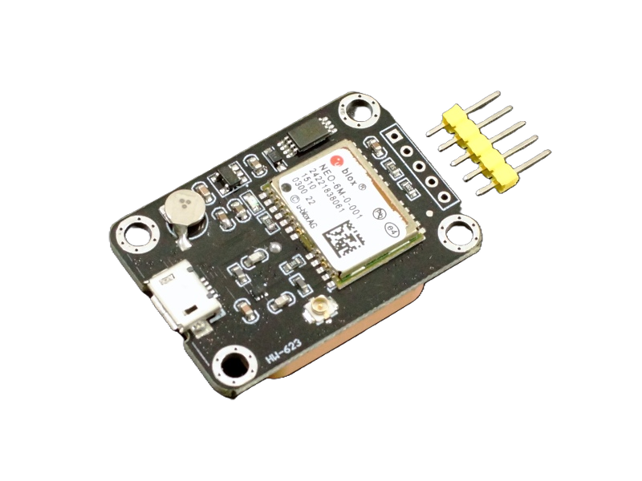
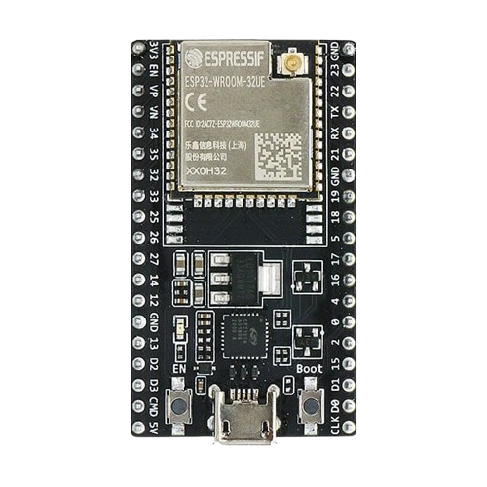
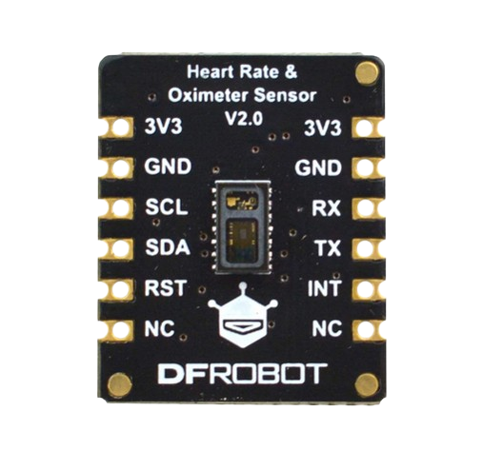
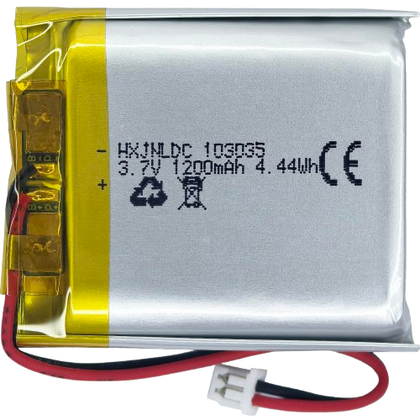
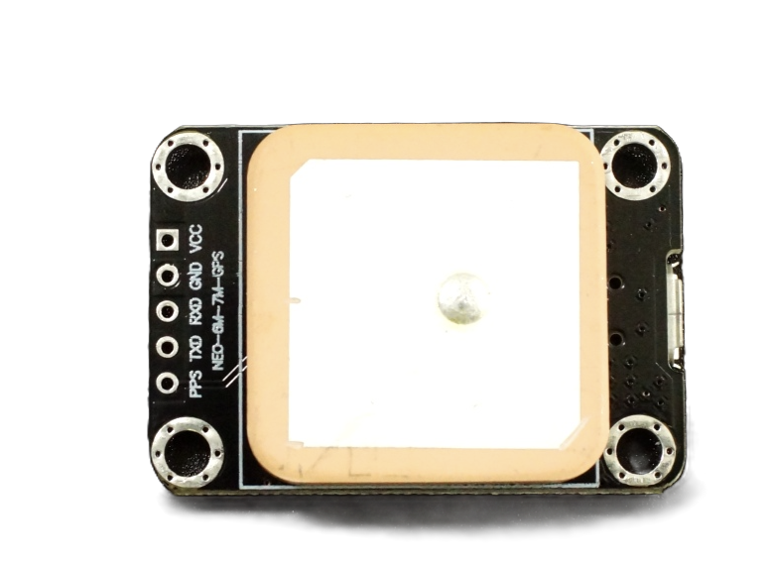
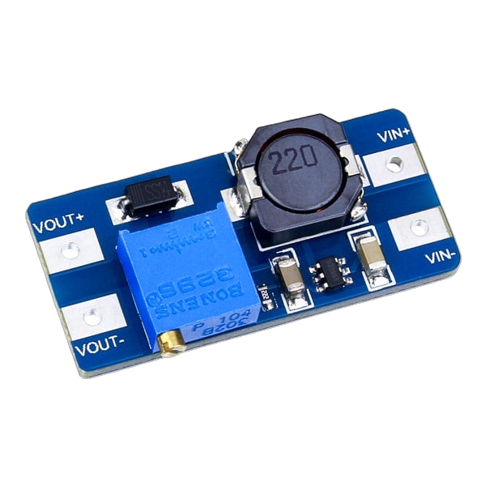
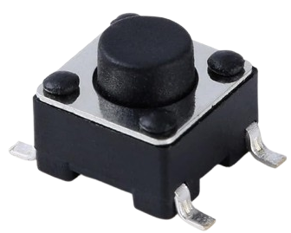
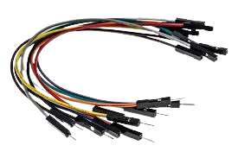
Hardware
NEO 6M GPS Module
MAX 30102
Heart Rate Sensor
3.7V 1200mAh
LiPo Battery
ESP32 DevkitC
Tactile Push Button Switches
Jumper Wires
Step-Up
DC Converter
Notes:
Tommy

Slide 4
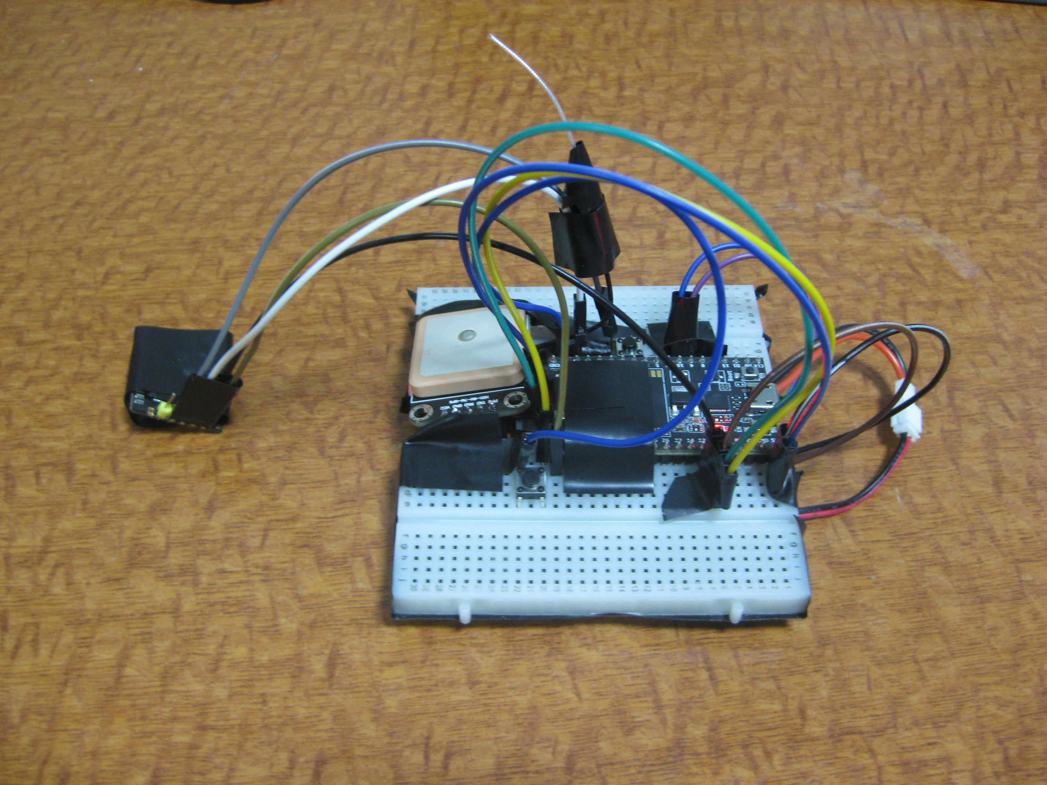
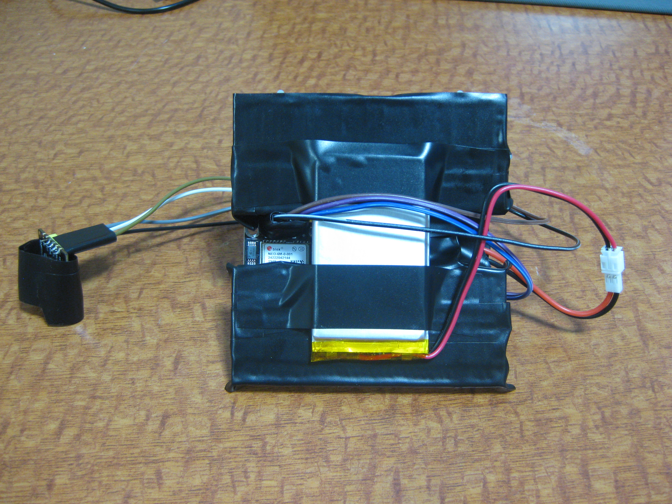
Hardware design
Top View (HR, GPS, Board, Wiring)
Bottom View (Converter, Battery, Wiring)
Notes:
Hardware Design

Slide 5
Software Design
Firmware
Application
Written with Arduino Core
Makes I2C communication and data transfer over serial simple
Forever Loop polls every 5 seconds:
HR Sensor talks over I2C
GPS Module talks over UART
Button presses
NMEA sentences are filtered
Uses LittleFS to write lines to ESP32 flash memory (when recording)
Downloaded later to be processed by application
Executable application displays data using the pywebview library
Displays GPS data on top half of screen and heart rate data on bottom
GPS location markers overlaid on map using Leaflet library
User has options to upload data from the device or view previous workouts
Data sent over serial connection from the device to computer
After upload, data is saved as a JSON file and stored in application folder
Notes:
Aidan/DeMuth
NMEA sentences are a standard for marine electronics to communicate

Slide 6
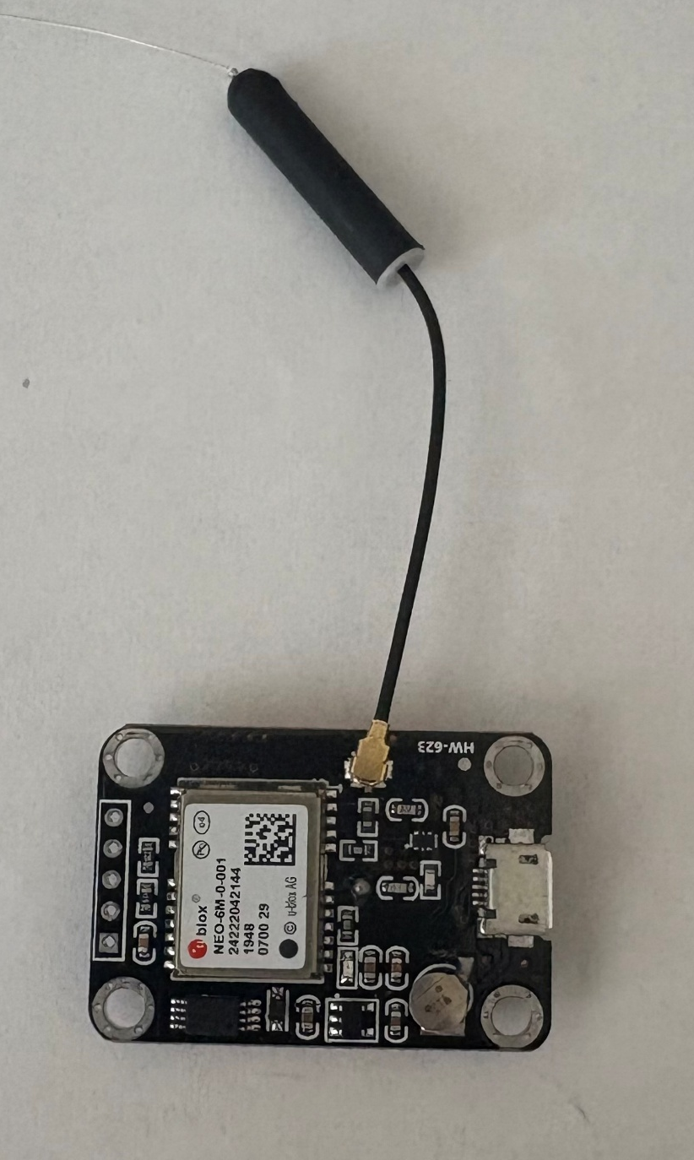
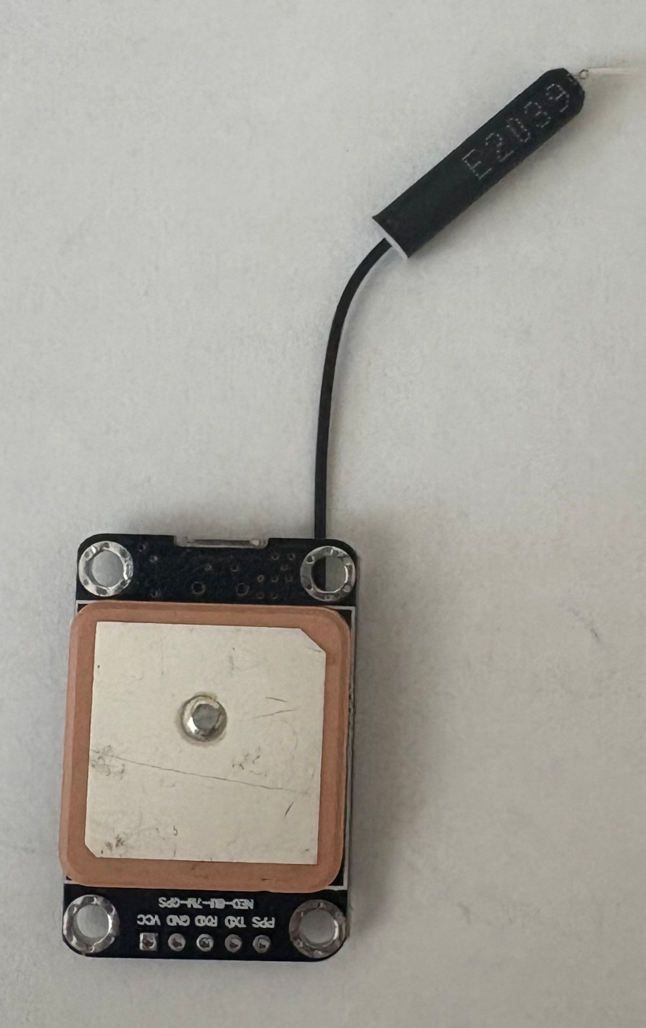
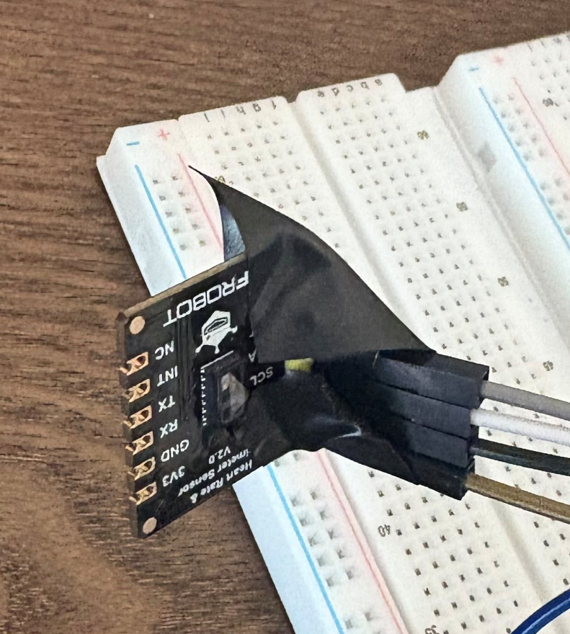
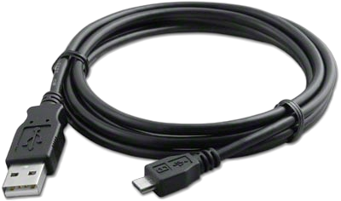
Roadblocks
GPS Module effectively required the antenna, ceramic patch was insufficient
Extremely difficult to get a fix
Heart rate sensor barely worked without solder
Needed to be pressed into the skin, cannot lightly sit on top
Need to block out ALL ambient light
We had to make compromises with our initial design
Data transfer over Wi-Fi worked initially, but began failing
Notes:
Aidan GPS HR – Tommy Wifi

Slide 7
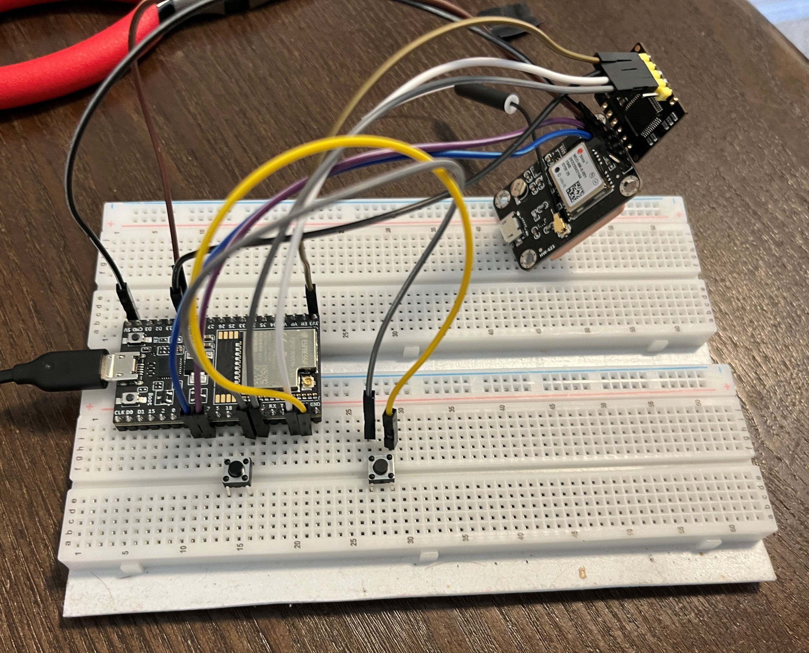
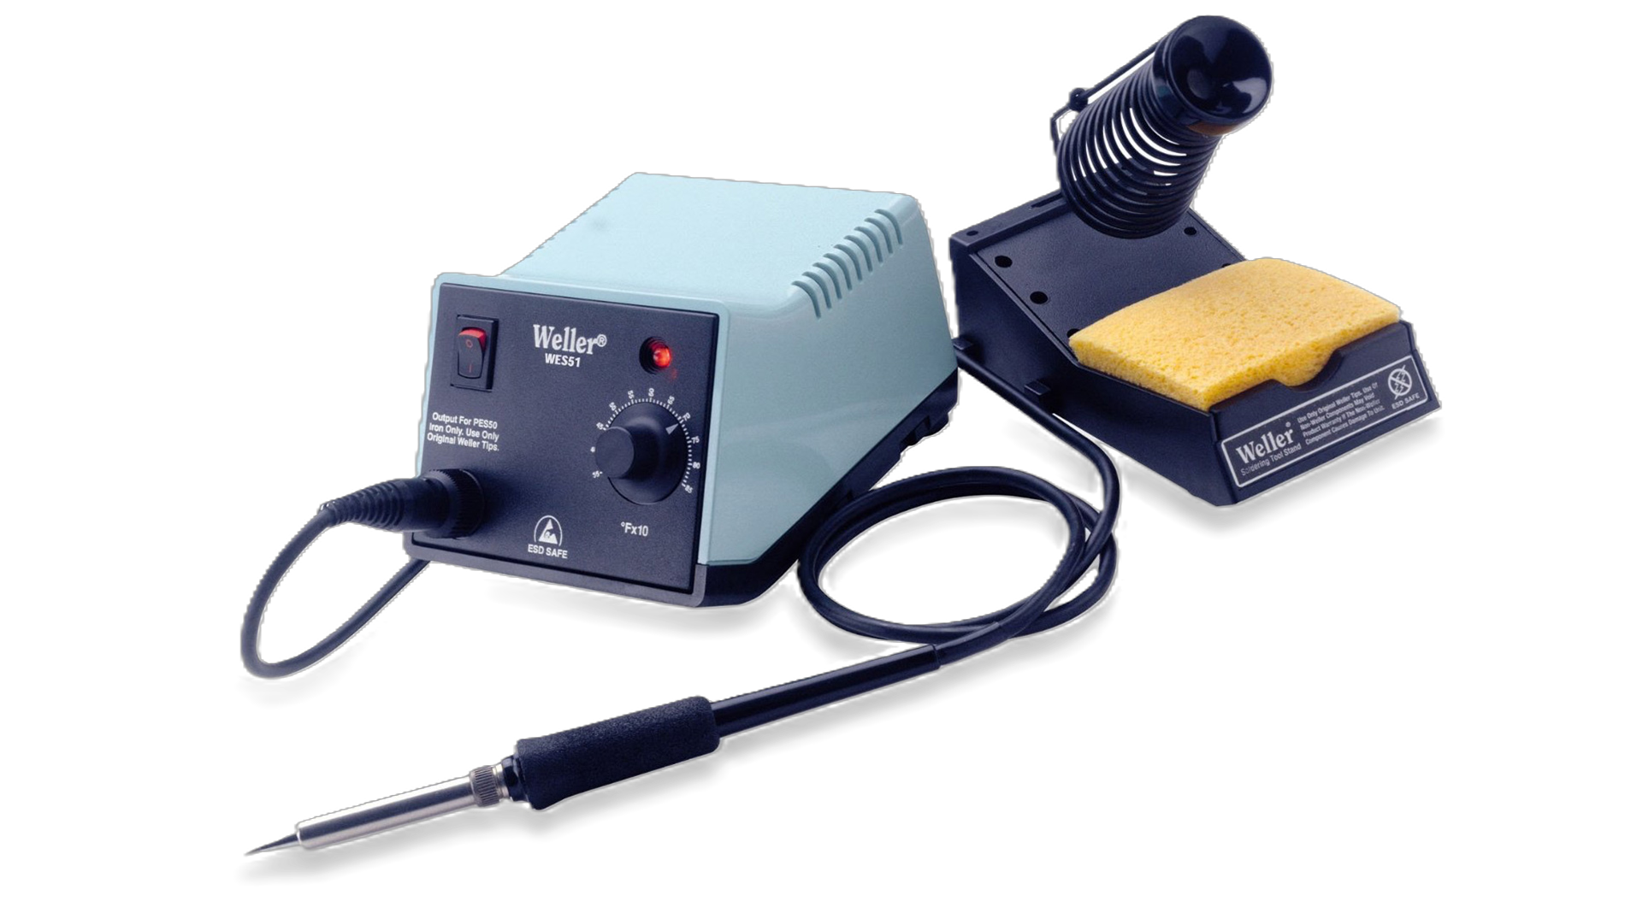
What did we learn?
While working on this project, we learned that hardware can be…
Unpredictable
Inaccurate (When you’re working on a budget)
Frustrating to Learn
Despite these hardships, we also learned many important skills that may help us on similar projects in the future:
How to solder components to a board
How to use Arduino IDE to write the code for a microcontroller
How to correctly wire a circuit without getting electrocuted
How to divide up workloads that depend on each other

Slide 8

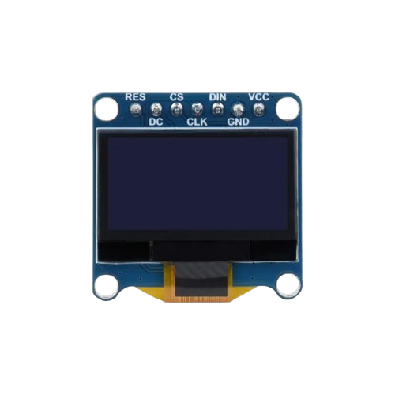

Future Additions
1
Use CAD to design a proper case and strap that still exposes HR sensor to skin
2
OLED display that shows a live metric (AVG pace)
3
Improved biometric data on application side
Notes:
Aidan

Slide 9
Contributions
Aidan
Tommy
Wrote firmware
NMEA Parsing
Physical wiring
Soldering
Wiring blueprint
Application
Physical wiring
Physical testing
Notes:
Both

